Slide 1
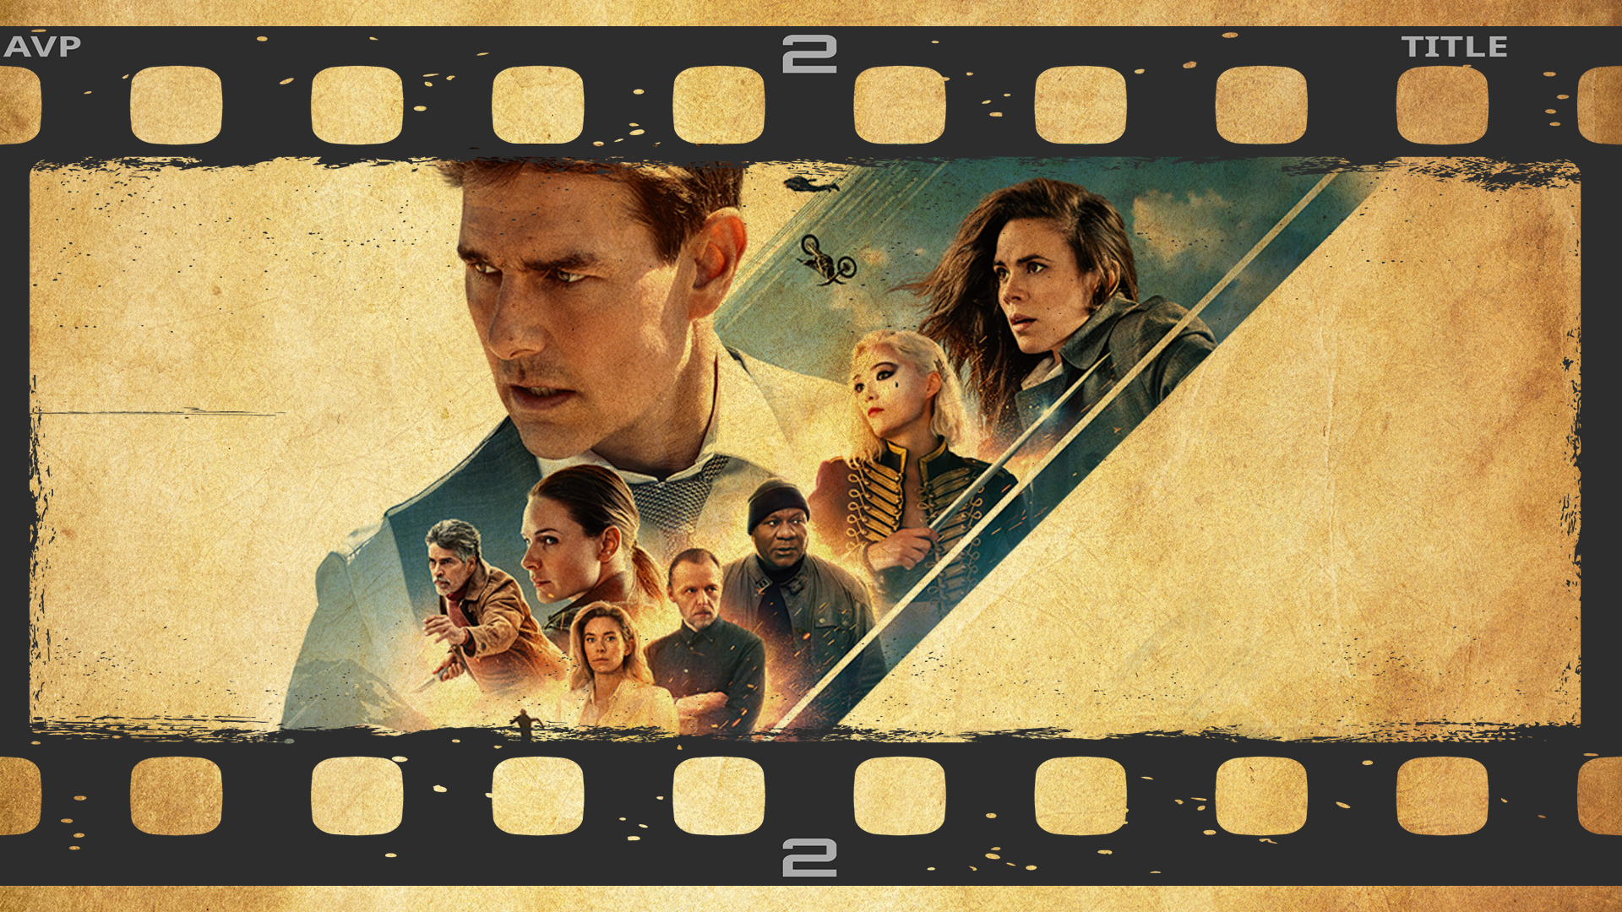
Permission Impossible
Dead Reckoning Pain

Slide 2




Slide 3
Acknowledgements

Slide 4
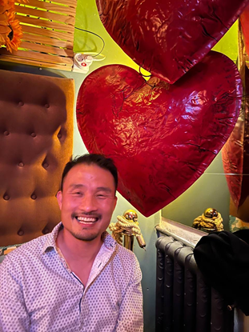
Shameless Self-Plug
Francis Chung
Co-Organiser of Alt.Net and DDD-AU Meetups
30 years in the industry
My first computer was an Apple II
Currently

Slide 5
Once upon a time ….

Slide 6


Slide 7
An Impossible Mission was given

Slide 8
Introduce a new User Class The FIRM Accountant

Slide 9
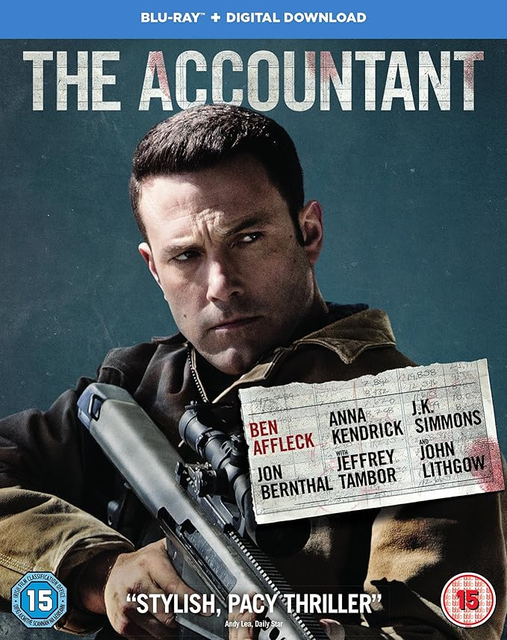
Not this Accountant
with the firm grip

Slide 10
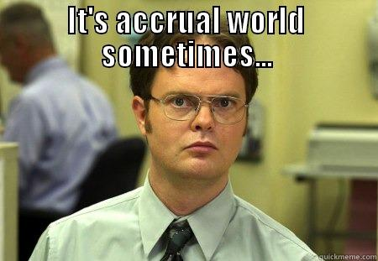
More like this guy with the undeniably Firm Accountant looks … if looks could Accrual

Slide 11
Analysis
933 different code changes spanning across 6 systems

Slide 12
Analysis
933 different code changes spanning across 6 systems
Given 1 intern Developer as a resource

Slide 13
Analysis
933 different code changes spanning across 6 systems
Given 1 intern Developer as a resource
I wasn’t allowed to code

Slide 14
Analysis
933 different code changes spanning across 6 systems
Given 1 intern Developer as a resource
I wasn’t allowed to code
I had 2 months to deliver

Slide 15
Your project / sanity will self destruct in ….

Slide 16
Permission Impossible
Dead Reckoning Pain

Slide 17
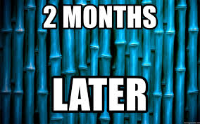
Roughly Speaking …

Slide 18
Project Delivered!

Slide 19
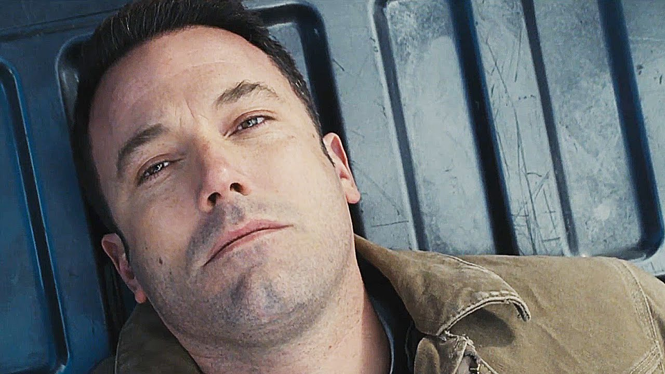
On Reflection …

Slide 20
What I should have done

Slide 21
There has to be a better way !

Slide 22
THE END - Part 1

Slide 23
Part 2 - Deeper Dive

Slide 24

Agenda

Slide 25
Authentication vs Authorization

Slide 26
Authentication -
Are you who you say you are?

Slide 27
Authorization - As user X =>
What are you allowed to do? What AREN’T you allowed to do?

Slide 28
Authentication vs Authorization

Slide 29
Typical Code for checking permissions
def put(self, business_uuid):
if not self.permission.can_update():
raise ForbiddenError
# ... do some updates ...
class <BusinessSetting>Permission(BasePermission):
def can_read(self):
return self.role in [
self.BUSINESS_OWNER_ROLE,
self.BUSINESS_PARTNER_ROLE,
self.ACCOUNTANT_PARTNER_ROLE,
]
def can_update(self):
return self.role in [
self.BUSINESS_OWNER_ROLE,
self.BUSINESS_PARTNER_ROLE,
self.ACCOUNTANT_PARTNER_ROLE,
]

Slide 30
Typical Code for checking permissions
def put(self, business_uuid):
if not self.permission.can_update():
Raise ForbiddenError
# ... do some updates ...
class <BusinessUnit>Permission(BasePermission):
def can_read(self):
return self.role in [
self.BUSINESS_OWNER_ROLE,
self.BUSINESS_PARTNER_ROLE,
self.ACCOUNTANT_PARTNER_ROLE,
]
def can_update(self):
return self.role in [
self.BUSINESS_OWNER_ROLE,
self.BUSINESS_PARTNER_ROLE,
self.ACCOUNTANT_PARTNER_ROLE,
]
Role Based Security
Role based Access Control
(RBAC)

Slide 31
Pros & Cons with RBAC (Role based)
Pros
Simple
Easy to implement
Great for small/medium apps
Well defined Permission Set that doesn’t change

Slide 32
Pros & Cons with RBAC (Role based)
Pros
Simple
Easy to implement
Great for small/medium apps
Well defined Permission Set that doesn’t change
Cons
Not suitable for Enterprise / SAAS
Difficult to change or introduce new permissions
Simple, Low Granular Permissions
Tight Coupling

Slide 33
Are there Alternatives out there?
Notes:
Just filled my Cat meme Quota. Check

Slide 34
Attribute Based Access Control (ABAC)
In a Nutshell : -
Method of doing Access Control over attributes across 4 areas
Subject (User)
Resource
Action
Environment

Slide 35
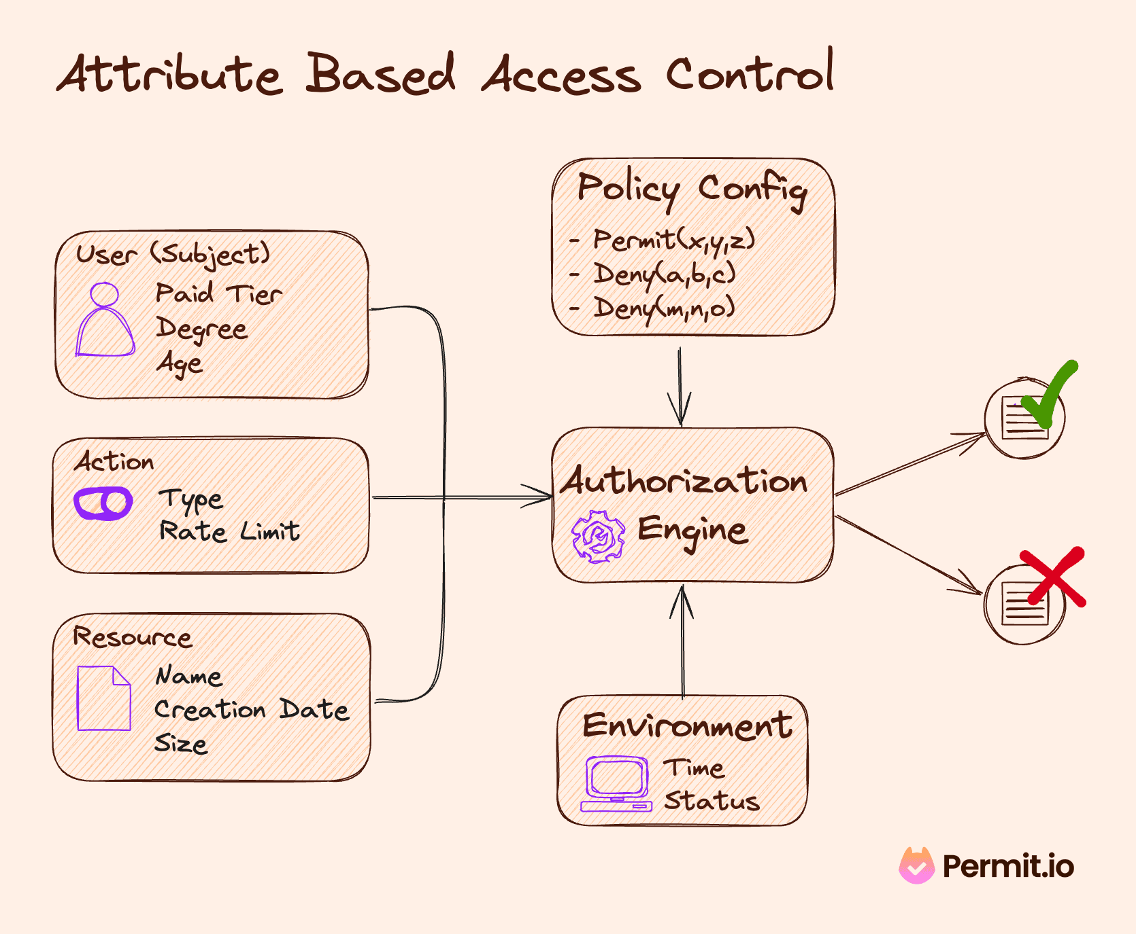

Slide 36
Attribute Based Access Control (ABAC)
Pros
Granular / Flexible Permissions
Easy to implement
Scalable
Better Security + Compliance

Slide 37
Attribute Based Access Control (ABAC)
Pros
Granular / Flexible Permissions
Easy to implement
Scalable
Better Security + Compliance
Cons
Complex!
Performance - Latency
XACML - Extensible Access Control Markup Language

Slide 38
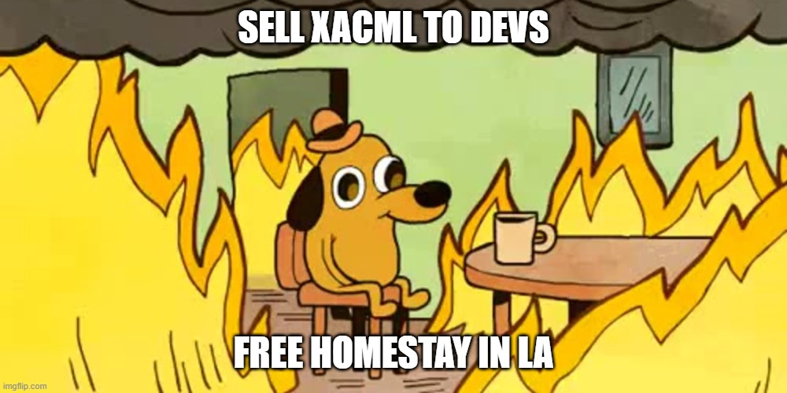

Slide 39
Notes:
Just filled my Cat meme Quota. Check

Slide 42
References
https://www.permit.io/blog/what-is-abac

Slide 52
Analysis
933 different code changes spanning across 6 systems

Slide 55
Analysis

Slide 56
Analysis

Slide 57
Analysis

Slide 68
There has to be a Better Way !

Slide 69
MOVIE DESCRIPTION
Mission: Impossible is a thrilling action movie franchise following IMF agent Ethan Hunt and his team as they undertake high-stakes missions to protect the world from dangerous threats. With breathtaking stunts and intense plots, the series showcases Hunt's unwavering determination and teamwork against formidable adversaries. This iconic franchise continues to deliver high-octane entertainment and captivate audiences worldwide.

Slide 70
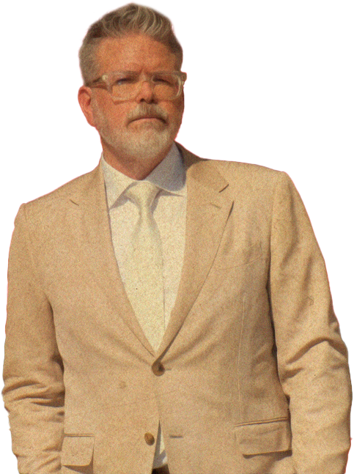
Director
Christopher McQuarrie
Christopher McQuarrie is an accomplished American filmmaker known for his work as a director, screenwriter and producer. He has had a significant impact on the Mission: Impossible movie franchise, particularly in his role as a director. Here are some key points about Christopher McQuarrie's contributions:

Slide 71
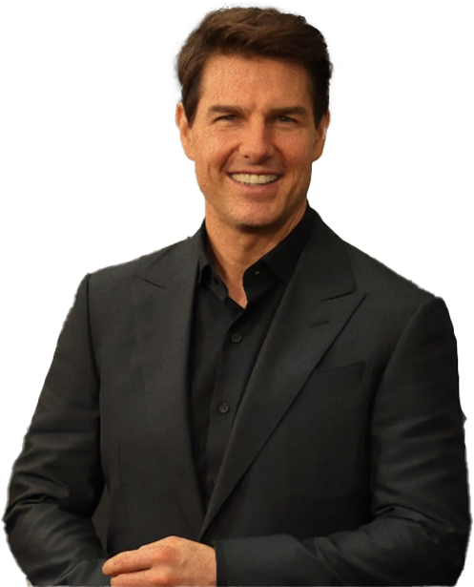
Director
Christopher McQuarrie
Ethan Hunt
Tom Cruise
Ethan Hunt the charismatic and skilled IMF agent, known for his unwavering determination, resourcefulness, and willingness to go to extreme lengths to complete his missions. Throughout the franchise, Ethan's character evolves, facing personal and professional challenges that shape his identity as a dedicated agent.

Slide 72
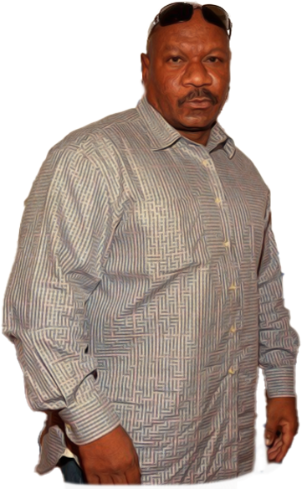
Director
Christopher McQuarrie
Luther Stickell the loyal technical expert and long-time friend of Ethan Hunt. Luther provides crucial support to the IMF team with his hacking and technical skills. He serves as a dependable ally and a valuable member of the team.
Ving Rhames
Luther Stickell

Slide 73
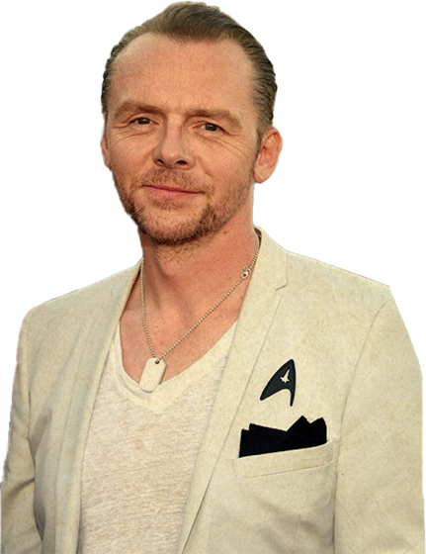
Benji Dunn
Simon Pegg
Benji Dunn The comic relief and tech-savvy member of the IMF. Benji adds levity to intense situations with his witty humour and brings essential technical expertise to the team. His unique personality complements the group dynamic.

Slide 74
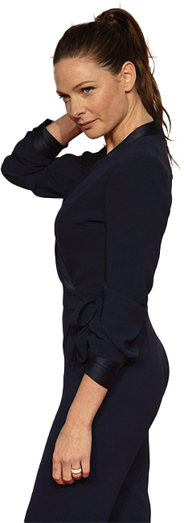
Ilsa Faust an enigmatic and complex character, Ilsa Faust alternates between ally and adversary to Ethan Hunt. Her intriguing background and motivations add depth to the storyline, making her an essential part of the franchise.
Ilsa Faust
Rebecca Ferguson

Slide 75
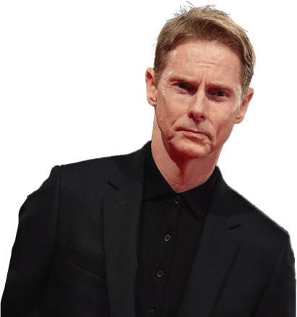
Solomon Lane
Sean Harris
Solomon Lane The cunning and menacing antagonist, responsible for challenging the IMF team and Ethan Hunt in particular. Lane's role as a formidable foe adds tension and suspense to the movies.

Slide 76
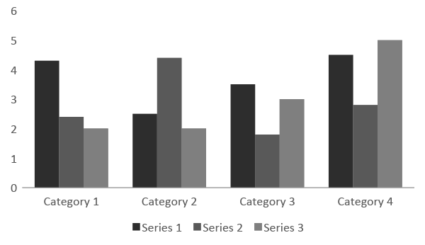
CRITICAL AND COMMERCIAL SUCCESS

Slide 77
Mission: Impossible - Rogue Nation
Mission: Impossible - Fallout
Mission: Impossible – Dead Reckoning Part One
2018
2015
2023
$682,716,636
$791,657,398
$370,853,469

Slide 78
MUSIC DERECTORS
Mission: Impossible - Rogue Nation (2015)
Composed by Joe Kraemer
Mission: Impossible - Fallout (2018)
Composed by Lorne Balfe
Mission: Impossible - Fallout (2018)
Composed by Lorne Balfe

Slide 79
Mission: Impossible - Rogue Nation (2015):
Nominated for a BAFTA Award for Best Special Visual Effects.
Mission: Impossible - Fallout (2018):
Nominated for two Academy Awards in the categories of Best Film Editing and Best Sound Editing.
Critics' Choice Movie Awards:
Mission: Impossible - Fallout won the Critics' Choice Movie Award for Best Action Movie in 2019.
Saturn Awards:
Various Mission: Impossible movies have received nominations and awards from the Academy of Science Fiction, Fantasy & Horror Films.
AWARDS

Slide 80



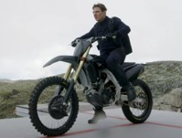
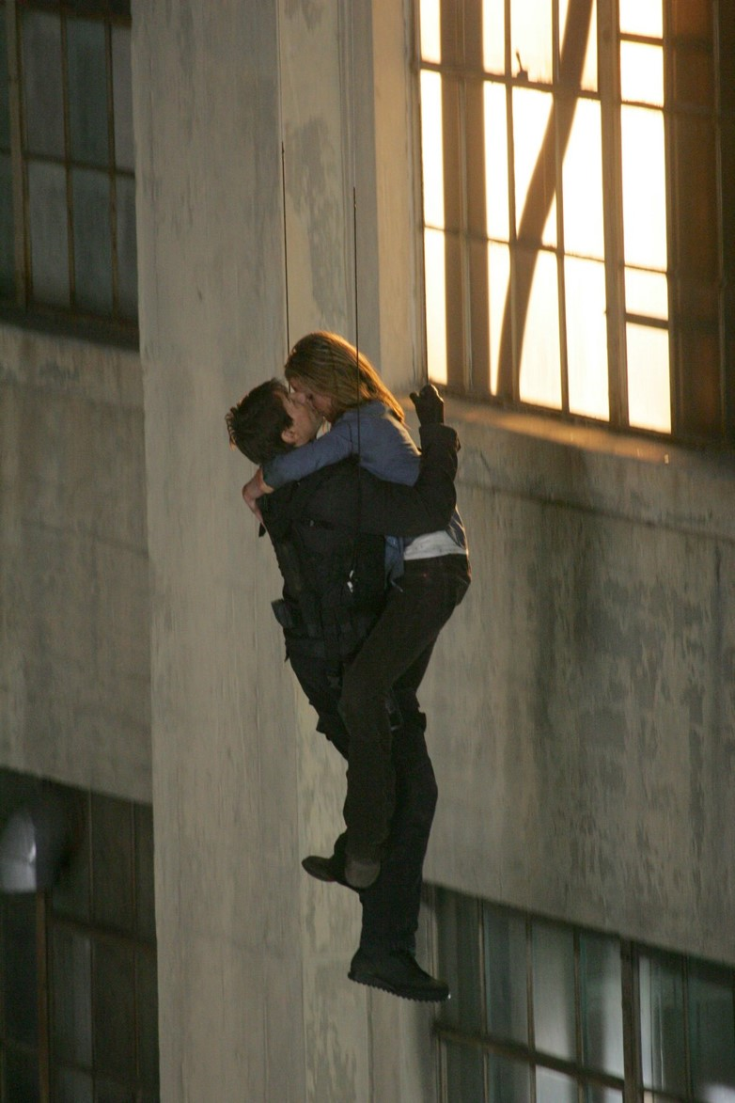
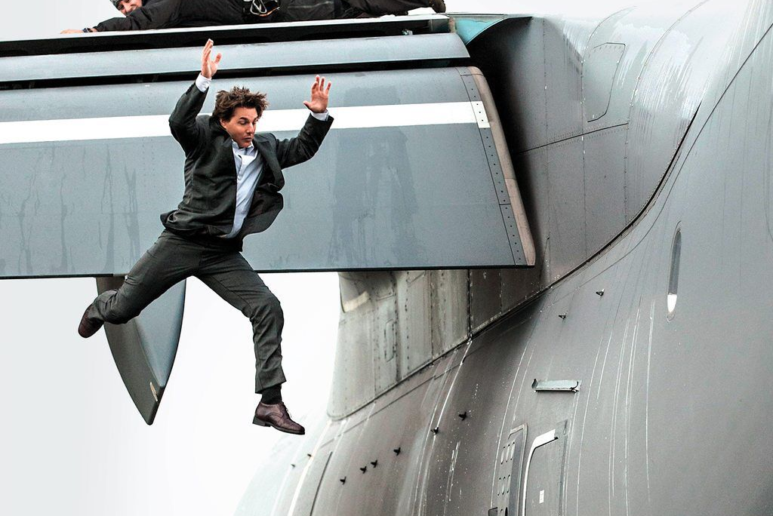
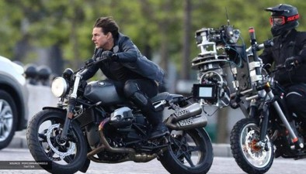
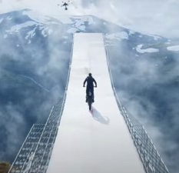
BEHIND THE SCENES

Slide 81
CONCLUSION
The enduring success of the Mission: Impossible franchise is truly remarkable. Spanning decades, it consistently delivers thrilling action, captivating characters and mind-bending plots. With each instalment, it sets new standards for action filmmaking, leaving an indelible mark on popular culture. We admire the creativity, passion and dedication that keep Mission: Impossible a global cinematic phenomenon. Here's to its ongoing inspiration and entertainment for audiences worldwide.

Slide 82
You must credit Slidechef in order to use this template
What you are allowed to do :
Modify this template
Use it for personal or commercial projects
What you are not allowed to do :
Offer Slidechef templates for download
Sublicense, sell or rent any Slidechef content
Distribute Slidechef content unless it has been authorized
Include Slidechef content in an online or offline file
Acquire the copyright of Slidechef content
INSTRUCTIONS
FOR USE

